Slide 1

Neural Network

Slide 2
What is Neural Network
If you’ve heard anything about a neural network, it’s probably something like, “It’s designed to work like the human brain.” Our brain is made of neurons—hence, a “neural” network.
If your neuroscience is a little rusty, don’t worry. In reality, it’s just an algorithm, or set of instructions, that’s used in deep learning to do things like image recognition, object detection, fraud detection, and natural language processing (NLP).
But wait, there’s another term I snuck in there: deep learning. What’s that? Is it the same as machine learning (ML)?
Perhaps an illustration will help differentiate between artificial intelligence, machine learning, and deep learning.

Slide 3
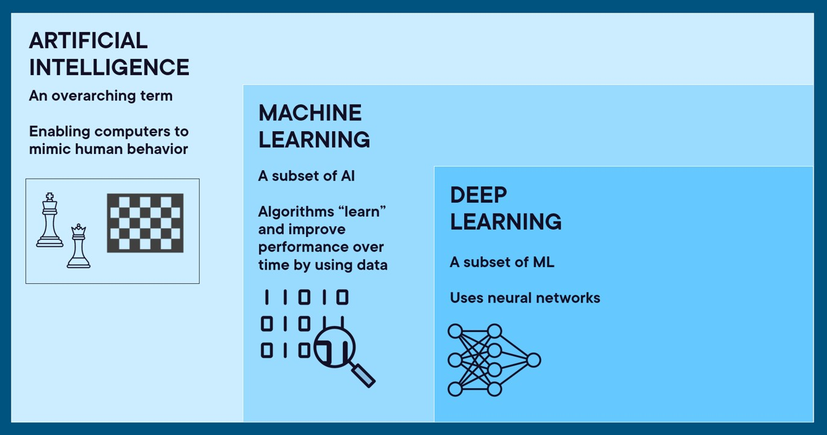

Slide 4
Artificial intelligence is at the top level. This is an overarching term that means we’re enabling computers to mimic human behavior, like a computer playing chess against a human.
Machine learning is a subset of AI. ML is about algorithms using data to learn and improve performance over time. For instance, you pass in data about what credit card fraud looks like, the computer learns it, and then the computer can predict if a new incoming transaction is fraudulent.
Deep learning is a subset of ML. Here’s where the neural networks come in. This category of machine learning is typically used for more complex problems than “regular” machine learning, and it uses more data and more computing power. Using a structure/algorithm like the human brain gives us the power we need.
In broad terms, deep learning is a subset of machine learning, and machine learning is a subset of artificial intelligence. You can think of them as a series of overlapping concentric circles, with AI occupying the largest, followed by machine learning, then deep learning. In other words, deep learning is AI, but AI is not deep learning.

Slide 5
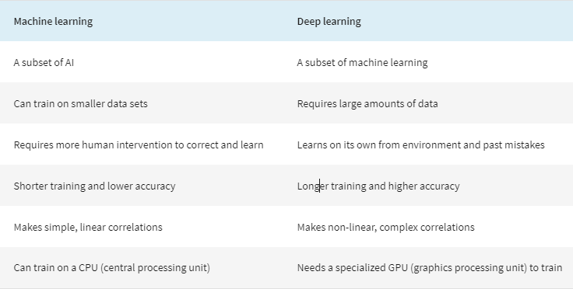
Deep learning vs. Machine learning
Machine learning and deep learning are both types of AI. In short, machine learning is AI that can automatically adapt with minimal human interference. Deep learning is a subset of machine learning that uses artificial neural networks to mimic the learning process of the human brain.

Slide 6
What is artificial intelligence (AI)?
At its most basic level, the field of artificial intelligence uses computer science and data to enable problem solving in machines.
While we don’t yet have human-like robots trying to take over the world, we do have examples of AI all around us. These could be as simple as a computer program that can play chess, or as complex as an algorithm that can predict the RNA structure of a virus to help develop vaccines.
For a machine or program to improve on its own without further input from human programmers, we need machine learning.

Slide 7
What is machine learning?
Machine learning refers to the study of computer systems that learn and adapt automatically from experience without being explicitly programmed.
With simple AI, a programmer can tell a machine how to respond to various sets of instructions by hand-coding each “decision.” With machine learning models, computer scientists can “train” a machine by feeding it large amounts of data. The machine follows a set of rules—called an algorithm—to analyze and draw inferences from the data. The more data the machine parses, the better it can become at performing a task or making a decision.
Here’s one example you may be familiar with: Music streaming service Spotify learns your music preferences to offer you new suggestions. Each time you indicate that you like a song by listening through to the end or adding it to your library, the service updates its algorithms to feed you more accurate recommendations. Netflix and Amazon use similar machine learning algorithms to offer personalized recommendations.

Slide 8
What is Deep Learning?
Where machine learning algorithms generally need human correction when they get something wrong, deep learning algorithms can improve their outcomes through repetition, without human intervention. A machine learning algorithm can learn from relatively small sets of data, but a deep learning algorithm requires big data sets that might include diverse and unstructured data.
Think of deep learning as an evolution of machine learning. Deep learning is a machine learning technique that layers algorithms and computing units—or neurons—into what is called an artificial neural network. These deep neural networks take inspiration from the structure of the human brain. Data passes through this web of interconnected algorithms in a non-linear fashion, much like how our brains process information.

Slide 9
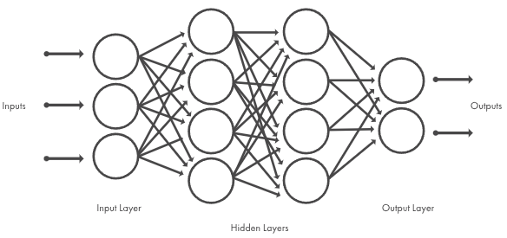
How does Deep Learning Work?
Deep learning models are based on neural network architectures. Inspired by the human brain, a neural network consists of interconnected nodes or neurons in a layered structure that relate the inputs to the desired outputs. The neurons between the input and output layers of a neural network are referred to as hidden layers. The term “deep” usually refers to the number of hidden layers in the neural network. Deep learning models can have hundreds or even thousands of hidden layers.
Deep learning models are trained by using large sets of labeled data and can often learn features directly from the data without the need for manual feature extraction. While the first artificial neural network was theorized in 1958, deep learning requires substantial computing power that was not available until the 2000s. Now, researchers have access to computing resources that make it possible to build and train networks with hundreds of connections and neurons.
High-performance GPUs have a parallel architecture that is efficient for deep learning. When combined with clusters or cloud computing, this enables development teams to reduce training time for a deep learning network from weeks to hours or less.

Slide 10
Types of Deep Learning Models
There are several types of neural networks, and each has a niche based on the data and problem you’re trying to solve. Here are a few of the more common networks and what they’re used for.
CNNs: A CNN convolves learned features with input data, and uses 2D convolutional layers, making this architecture well suited for processing 2D data, such as images. The CNN works by extracting features directly from images. The relevant features are learned while the network trains on a collection of images. This automated feature extraction makes deep learning models highly accurate for image classification tasks. CNNs can also be used for classifying other types of data, such as time series and text. Convolutional neural networks (CNN): Primarily used for image and video recognition, image classification, medical image analysis, and natural language processing.
ANN: Artificial Neural Network:- Not real Neuron Connection, Feed forward neural network.
RNNs: A recurrent neural network (RNN) is a network architecture for deep learning that predicts on time-series or sequential data. RNNs are particularly effective for working with sequential data that varies in length and solving problems such as natural signal classification, language processing, and video analysis. The long short-term memory (LSTM) network is a special type of RNN that is better in learning longer term dependencies than simple RNNs. Recurrent neural networks (RNN): Best for sequential data, such as time series analysis (think stock market analysis or weather forecasting), language modeling, and speech recognition.

Slide 11
Transformers: Transformers are designed to track relationships in sequential data. They rely on a self-attention mechanism to capture global dependencies between input and output. They are often used for natural language processing and they are the basis for large language models (LLMs) such as BERT and ChatGPT. ChatGPT is built using a transformer neural network. Kesha Williams has written a great article about Transformers in Gen AI.

Slide 12
How to Create Deep Learning Models
You can create a deep learning model from scratch or start with a pretrained deep learning model, which you can apply or adapt to your task.
Training from Scratch: To train a deep learning model from scratch, you gather a large, labeled data set and design a network architecture that will learn the features and model. This is a good approach for new or specific applications, or more generally, applications for which preexisting models do not exist. The main disadvantage of this approach is that it requires a large dataset (with the ground truth annotated) and the training time can take from hours to weeks, depending on your task and computing resources.
Transfer Learning: In deep learning applications such as image classification, computer vision, audio processing, and natural language processing, the transfer learning approach is commonly used. It involves fine-tuning a pretrained deep learning model. You start with an existing model, such as SqueezeNet or GoogLeNet for image classification, and feed in new data containing previously unseen classes. After making some tweaks to the network, you can now perform a new task, such as categorizing only dogs or cats instead of 1000 different objects. This also has the advantage of needing much less data, so the training time drops significantly.
A pretrained deep learning model can also be used as a feature extractor. You can use the layer activations as features to train another machine learning model (such as a support vector machine (SVM)). Or you can use the pretrained model as a building block for another deep learning model. For example, you can use an image classification CNN as the feature extractor for an object detector.

Slide 13
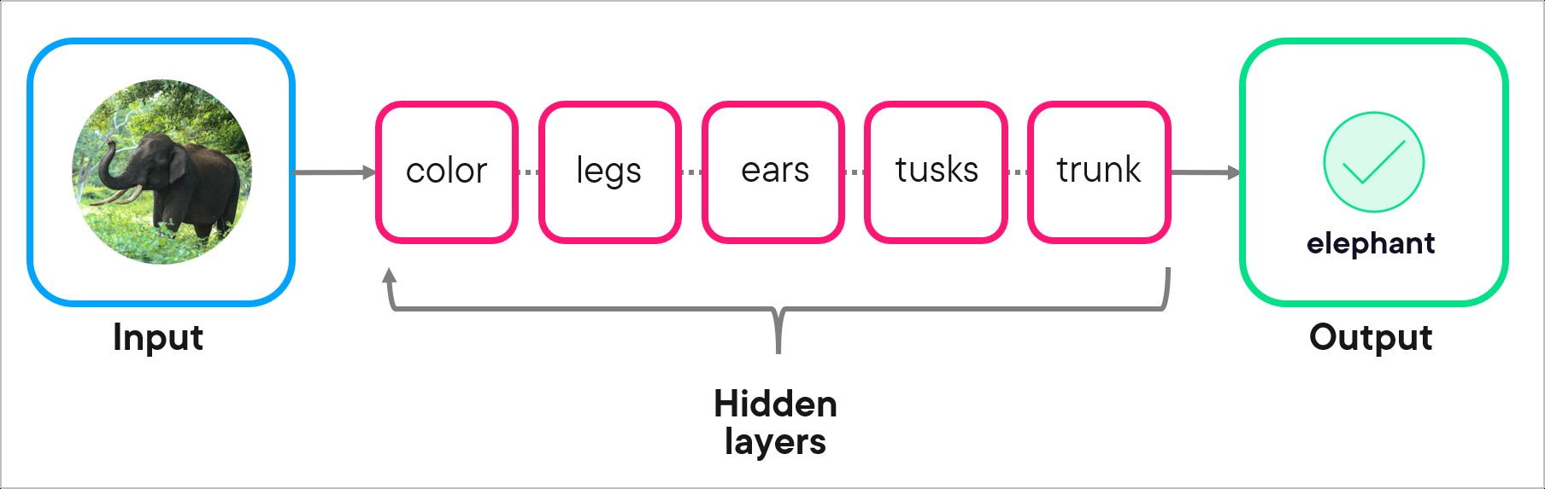
What are the key components of a neural network?
What are neurons and layers in a neural network?
Here again, an illustration might be helpful. This example network is used to do image detection, specifically on a picture of an elephant.
The input layer: The input layer is what you pass in. In our case, it’s an image, but even an image is really just data in the eyes of the computer. It could also be data like credit card transactions, insurance claims, or pictures of stop signs.
The hidden layers: Here’s where the work happens to identify the image (or whatever it is the neural network is meant to do). In our example, each layer is concerned with a different part of the elephant. One is focused only on color, another on counting the number of legs, and so on.
The output layer: This is the “answer” the network gives after it runs the data through the hidden layers. This is an elephant or it’s not. This is credit card fraud or it’s not. That kind of thing.

Slide 14
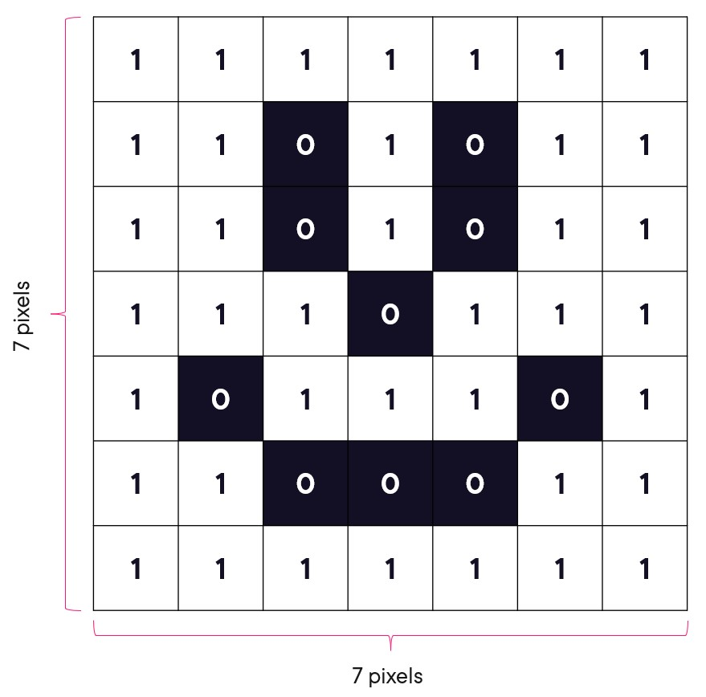
So what are the neurons?
To understand neurons (sometimes called nodes), let’s go to an even simpler example: an image of a smiley face. Remember that a computer sees images as data. In the case of this image, it “sees” each pixel in the image as a binary of 0 (for black) or 1 (for white).

Slide 15
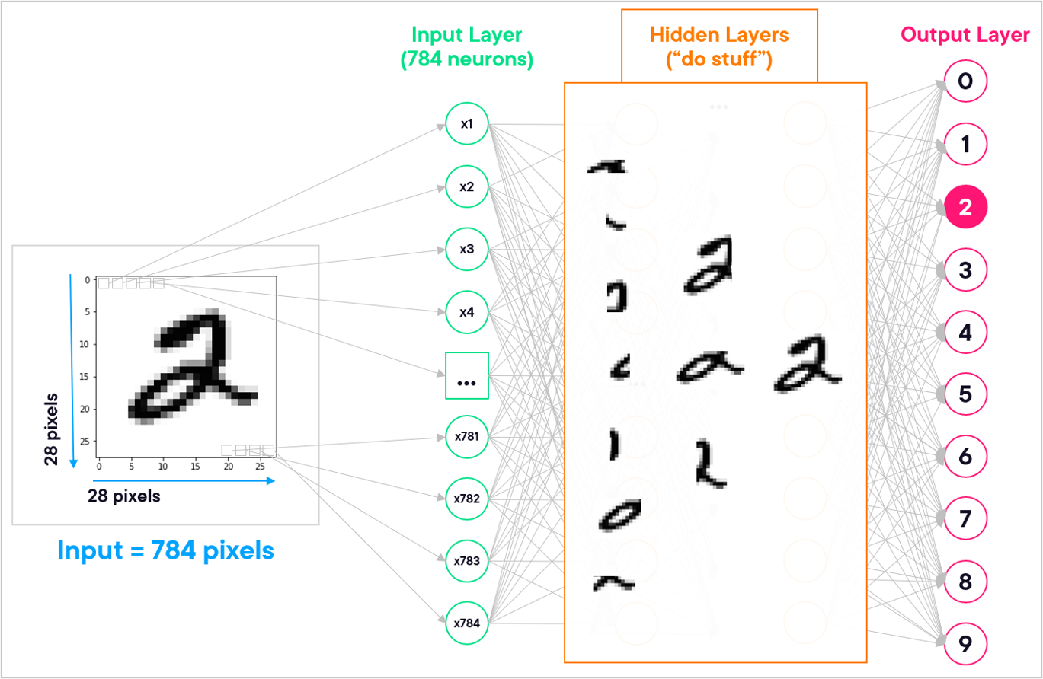
Pulling everything together in a more realistic example of identifying a handwritten “2,” we have something that looks like this:

Slide 16
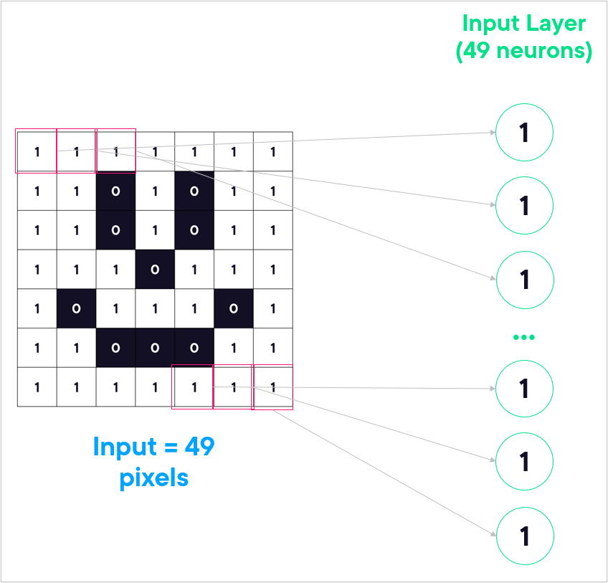
Because the image is 7 pixels by 7 pixels, that means we have 49 (7x7) pieces of data to feed into the network. Each piece of data becomes a neuron in the input layer. So effectively, a neuron holds some value in the network.

Slide 17
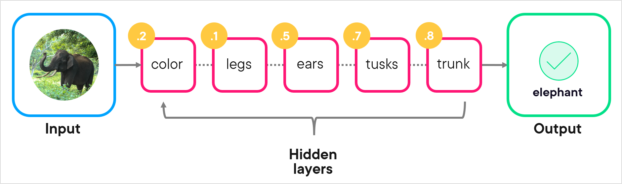
How do weights impact a neural network?
In the hidden layers of a neural network, not all things are created equal. Going back to our elephant example, some characteristics of the elephant are more important—or hold more weight—than others.
For instance, lots of animals have four legs, so we shouldn’t give “has four legs” a lot of weight when trying to identify the elephant. But the trunk or tusks would hold more weight, as these are more unique to an elephant.
So, we’ve added weights in the yellow circles in the image below.
As the network does its thing in the hidden layers, some characteristics are given more weight than others, helping us get to a more accurate prediction in the output layer.

Slide 18
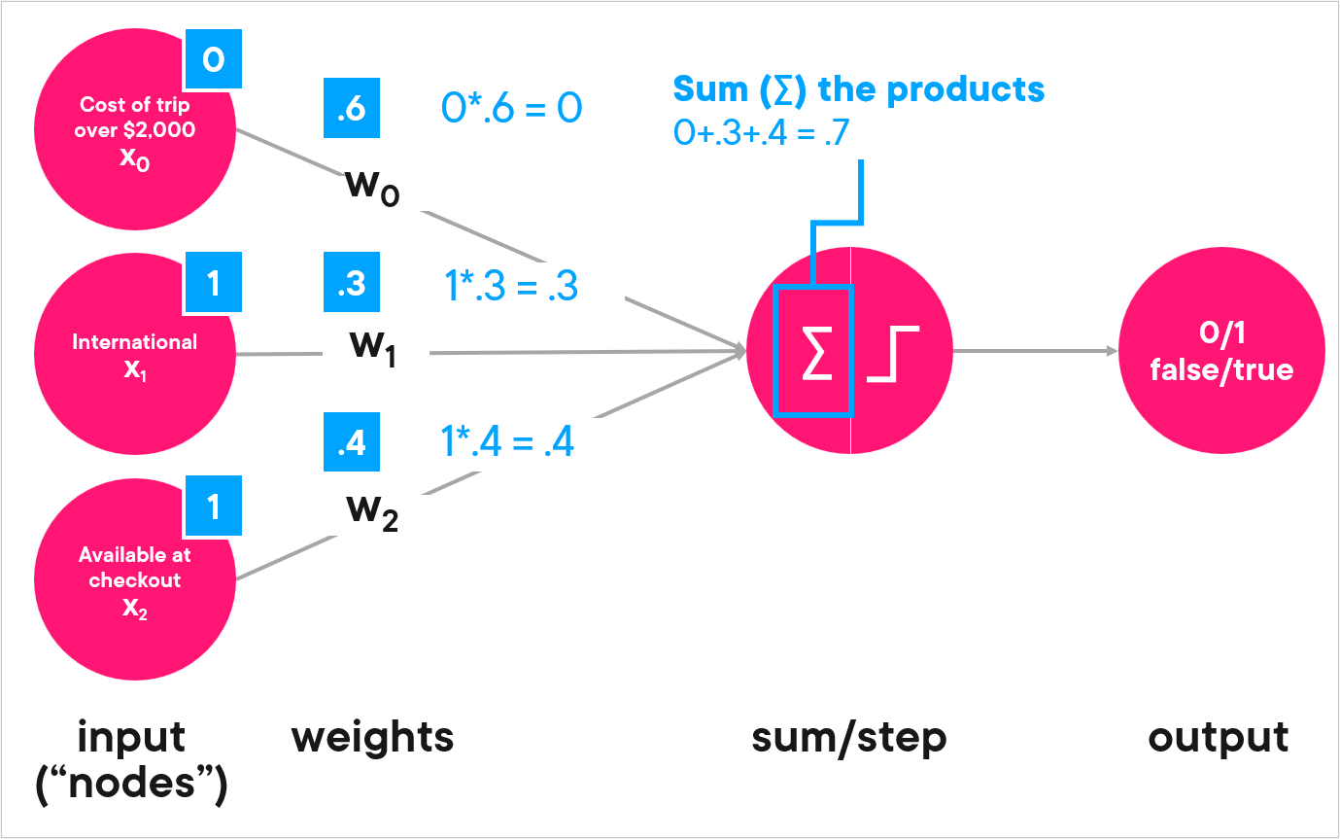
What is the purpose of activation functions?
Another important concept to understand in neural networks is the activation function. In simple terms, the activation function decides which information should move forward through the network and how much of it gets through.
Let’s look at another example, this one for predicting whether someone will buy travel insurance when they purchase a trip.
Step 1: The neuron receives inputs, each input having its own weight or importance.

Slide 19
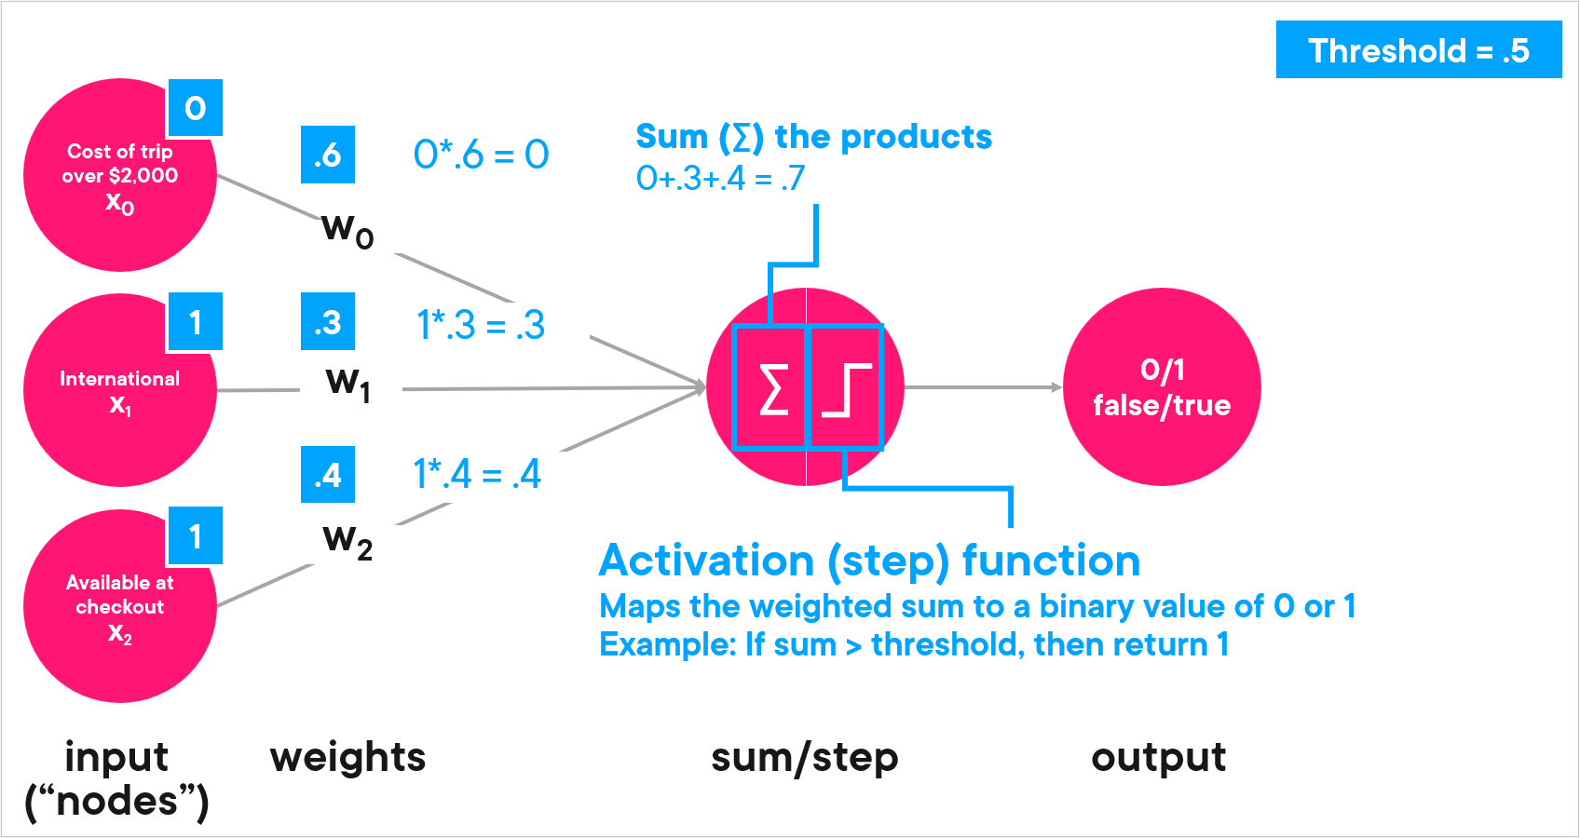
Step 2: It calculates a sum of these inputs (the sigmoid symbol in the middle of the diagram), adjusting for their weights.
Next up, the activation function part . . .

Slide 20
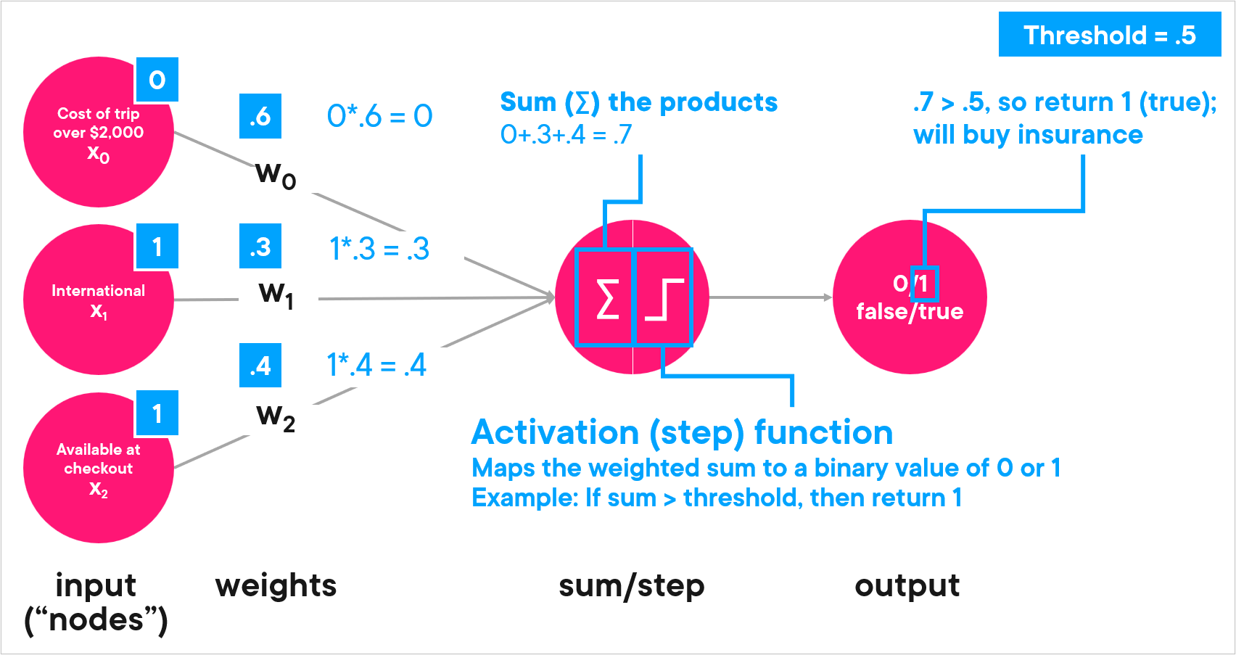
Step 3: The activation function looks at the sum and decides the output of the neuron. We’re going to use a simple function called a step function that says “if the sum is greater than a threshold of .5, then return 1; otherwise, return 0.” (Threshold is a value that we can set, and we chose .5.)
And the final answer . . .

Slide 21
Our sum of .7 is greater than .5, so in this example, we’d return 1 (true) and say that for this transaction, the traveler would buy travel insurance.
For this illustration, we used a simple activation function to return a binary value of 0 or 1. But there are many other activation functions. Here are some of the more common ones:
Sigmoid: Takes in a value and returns a probability between 0 and 1. For example: There’s a probability of 91% that the handwritten digit is a 2.
Rectified linear unit function (ReLU): Takes in a value X and returns the max of 0 or X. For example: Pass in a negative value X, and get a return value of 0; pass in a positive value X, and get a return value of X.
Softmax: Used on the last layer of a multi-class classification problem. For example: Classify whether something is a dog, cat, chicken, or goat.

Slide 22
How do neural networks learn?
You have a neural network with its neurons and layers and activation functions. But how does it actually “learn” anything?Learning comes from training. And training just means we provide lots and lots of labeled (i.e., “this is an elephant”) examples to the network until it “learns” and has a high rate of accuracy making predictions. The actual process of “learning” happens through backpropagation.
What is backpropagation?
To give you some insight into how this works, let’s see a human example. Imagine a teacher gives a group of school students puzzle pieces of an elephant and asks them to figure out what it is.
The students get into groups, with each group assigned a section of the puzzle. Once they come up with an answer about their section, they take it to their teacher’s assistant. (These are the “hidden layers” of the network.) The teacher’s assistant gathers up all the answers, takes it to the head teacher, and they have an overall answer of “we don’t think this is an elephant.”
The head teacher goes to the all-knowing label (the source of truth). The label says this IS an elephant, and tells the teacher to go fix the answer.

Slide 23
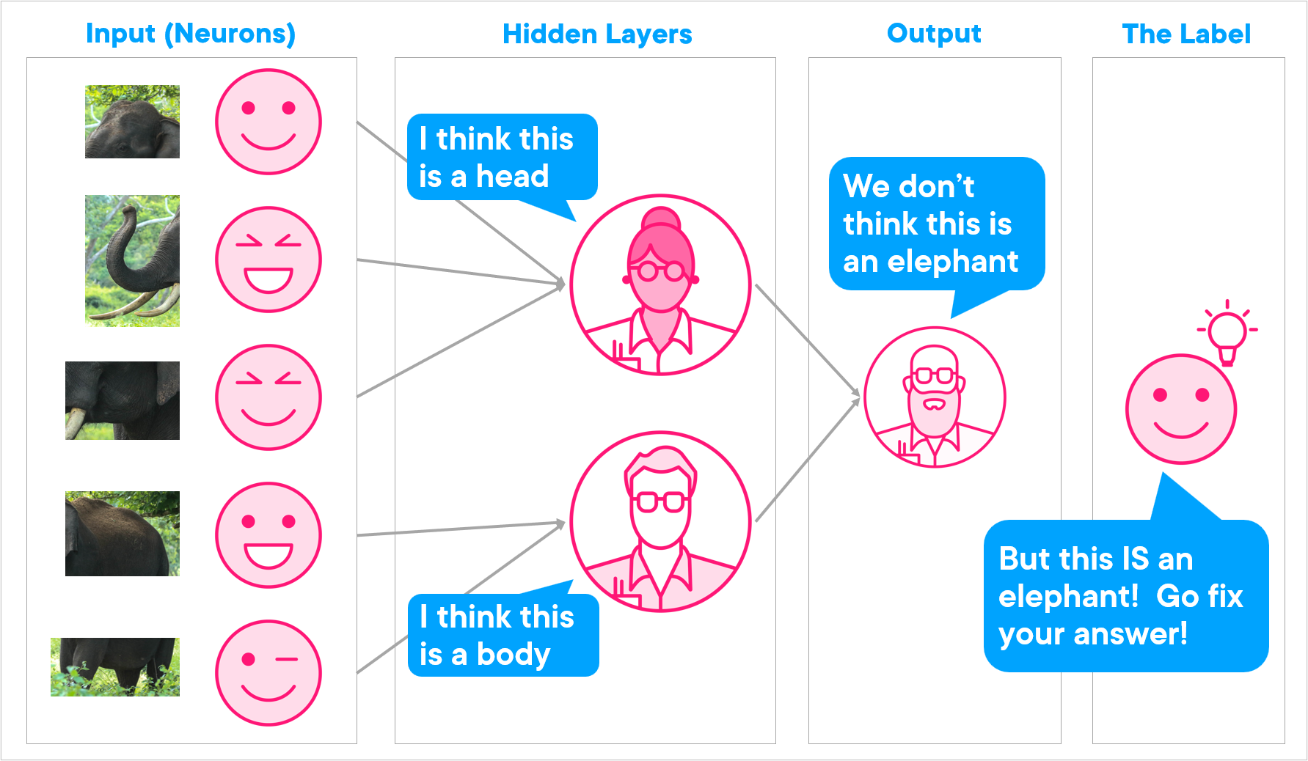
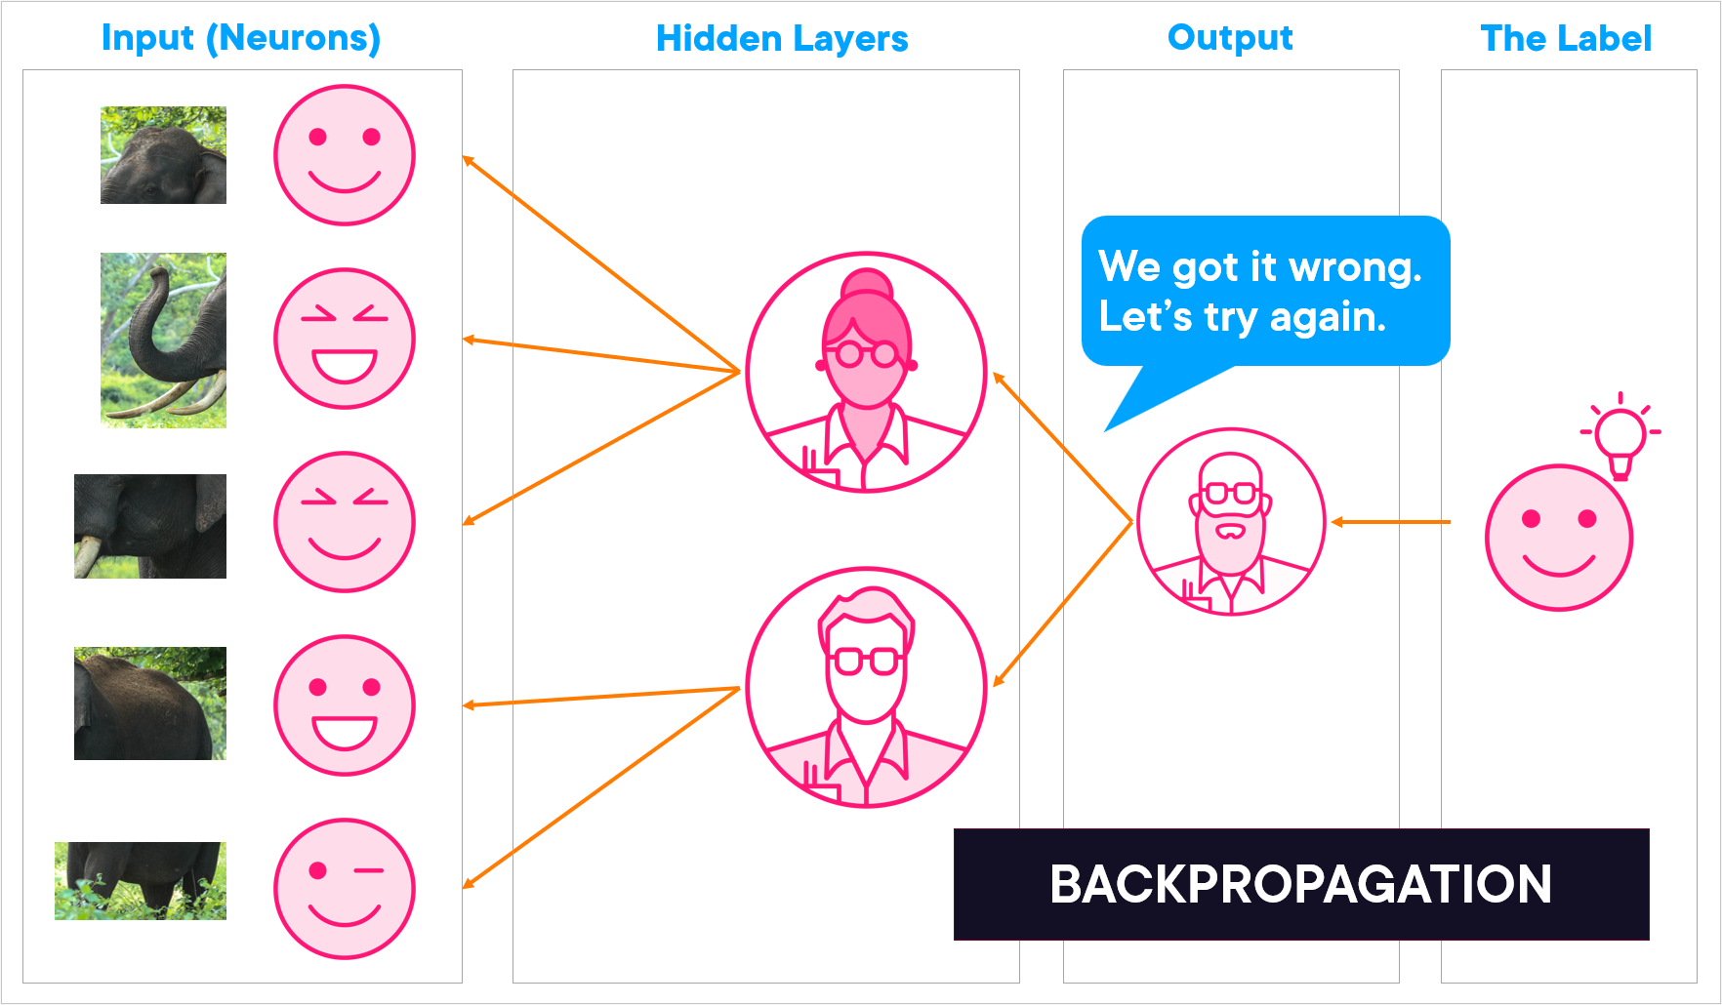
The teacher goes back to the teacher’s assistants, who take it back to the students, telling them they got the incorrect answer and they need to adjust to get the correct one.
This process of moving back through the network and correcting errors is called backpropagation, short for “backward propagation of errors.”

Slide 24
What is the purpose of loss functions?
Before you can backpropagate through a network and correct your errors, you need to know what to correct and by how much.
In neural network terms, we need to figure out how far off we were in our final answer. This is called the loss (or sometimes called error or cost).
For example, maybe we predicted that there’s a probability of .92 that this is an elephant, and the real answer should have been 1. Or perhaps it was really bad in its prediction and said there’s a probability of only .35.
Pulling in some math, the distance between what we wanted and what we got in these two examples is:
1 - .92 = .08 (a small loss or error; the model is pretty close)
1 - .35 = .65 (a large-ish loss or error; the model needs a lot of improvement)
Calculating the distance between what you wanted and what you predicted is done with a loss function.
Mean squared error (MSE): Used for regression problems like predicting continuous values of home or stock prices
Cross-entropy loss: Used for classification problems like “is this a cat or a dog?” or “is this email spam or not?”

Slide 25
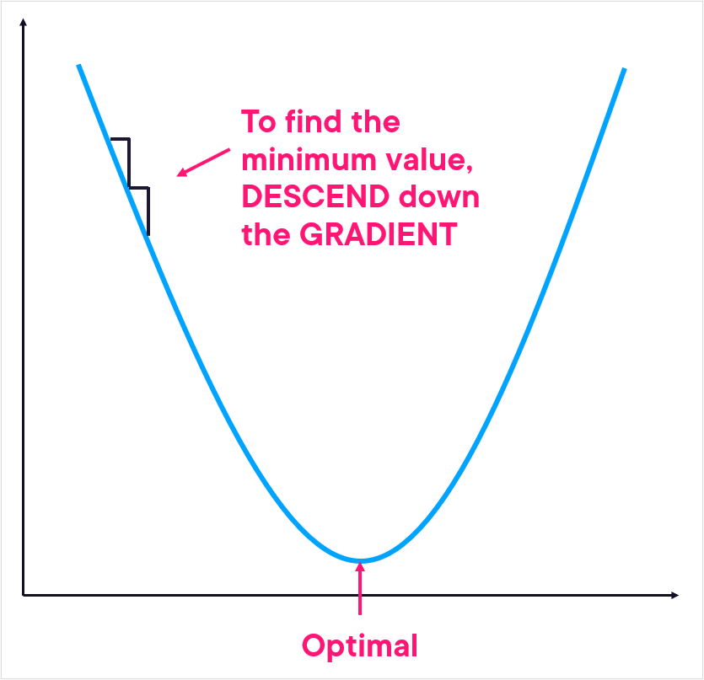
What is gradient descent?
Once you know how far off you are, you need to work towards improving that number. In other words, you want to minimize the loss (error/cost). The process of finding the minimum is known as gradient descent, sometimes called stochastic gradient descent.
Kind of like descending a mountain to get to the bottom, the gradient descent algorithm will try to find the optimal point at the bottom of the curve by descending the gradient of this line, iterating until it finds that lowest point.
Mainly it is used to fin the global minima.

Slide 26
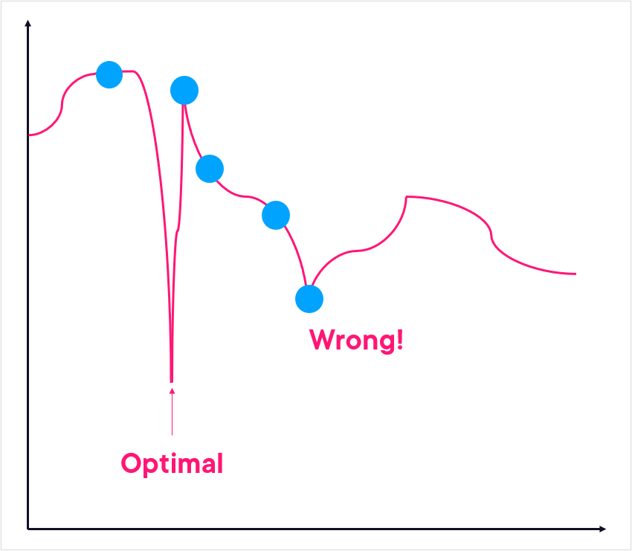
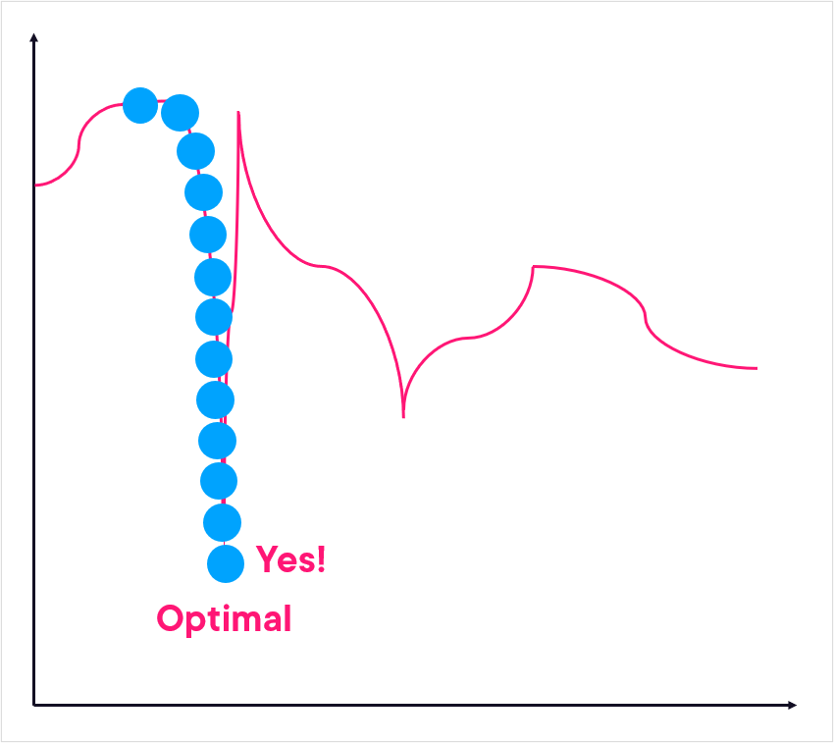
What is a learning rate?
As gradient descent is making its “steps” down the curve, the learning rate is effectively the size of its steps. And in general, you want to use small steps so you don’t miss something.
For example, if you had a large learning rate, and you were trying to find the optimal point on this line, you’d “step over” the gap down and miss the optimal point.
But with a smaller learning rate (i.e., smaller “steps”), you make a nice descent down the line to the optimal point.

Slide 27
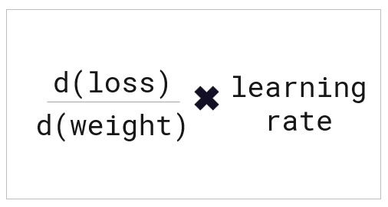
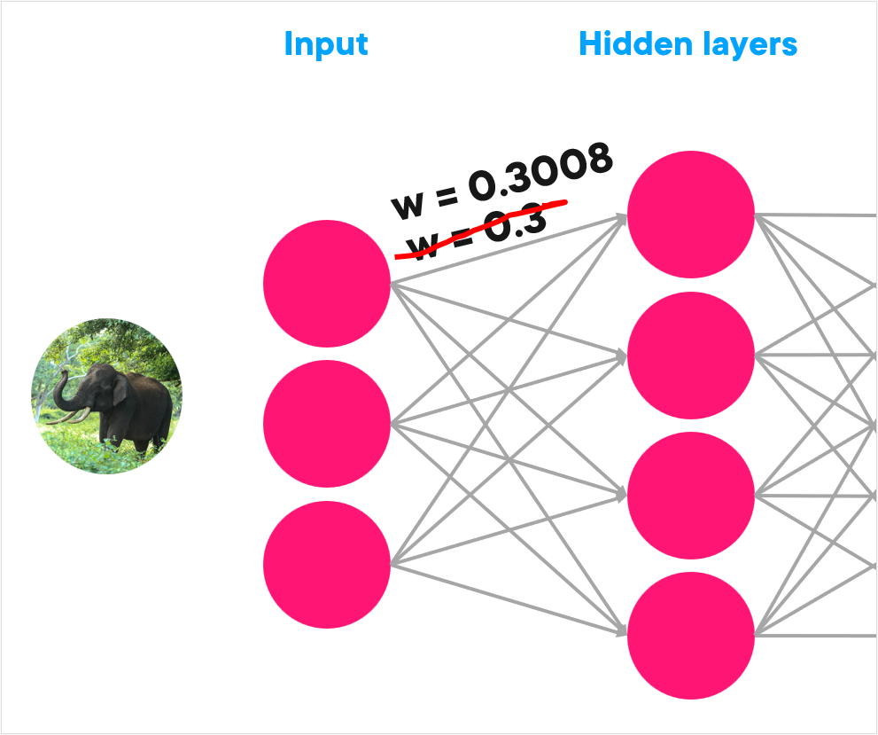
In mathematical terms, the learning rate is used to figure out how you’re going to update the weights in the neural network as you’re doing backpropagation. It’s used in this formula: derivative of the loss divided by the derivative of the weight times the learning rate.
This will result in a very small number, which means you’re making tiny updates to weights as you move back through the network. For example, with a single neuron and weight, perhaps by the time you get back to the top of the network, a weight is updated from 0.3 to 0.3008, and then you make a forward pass through the network again using the new weights.
Once you make it to the end, calculate the loss function again, figure out how much to update weights, then backpropagate to update them. This forward and backpropagation continues until you’ve minimized the overall loss for the network and get accurate predictions.

Slide 28
THANK YOU

